Slide 1

Introduction
Warshall's algorithm
Shortest path algorithm Floyd Warshall Algorithm (modified warshall algorithm)

Slide 2
What is a Graph?
A graph G = (V,E) is composed of:
V: set of vertices
E: set of edges connecting the vertices in V
An edge e = (u,v) is a pair of vertices
Example:
a
b
V= {a,b,c,d,e}
E= {(a,b),(a,c),(a,d),
(b,e),(c,d),(c,e),
(d,e)}
c
d
e

Slide 3
Adjacency Matrix and Path Matrix
Y
X
Z
W
0 | 0 | 0 | 1
1 | 0 | 1 | 1
1 | 0 | 0 | 1
0 | 0 | 1 | 0
0 | 0 | 1 | 0
1 | 0 | 1 | 2
0 | 0 | 1 | 1
1 | 0 | 0 | 1
1 | 0 | 0 | 1
1 | 0 | 2 | 2
1 | 0 | 1 | 1
0 | 0 | 1 | 1
0 | 0 | 1 | 1
2 | 0 | 2 | 3
1 | 0 | 1 | 2
1 | 0 | 1 | 1
A₁ =
A₂ =
A₃ =
A₄ =
Number of Paths between Y to W of length 3 are 2
(Y -> Z -> X -> W AND Y->W->Z->W)
B₄ = A₁ + A₂ + A₃ + A₄
  entry of matrix B₄ gives the number of paths of length 4 or less from node v_{i} to v_{j}
  entry of matrix B_{r} gives the number of paths of length r or less from node v_{i} to v_{j}

Slide 4
Warshall's algorithm
Repeat for I, J = 1, 2,…, M: [Initializes P.]
  If A[I, J] = 0, then: Set P[I, J] := 0;
  Else Set P[I, J] := 1.
  [End of loop.]
Repeat Steps 3 and 4 for K = 1, 2,…, M: [Updates P.]
Repeat Step 4 for I = 1, 2,…, M:
Repeat J= 1, 2,…, M:
Set P[I, J] := P[I, J] OR (P[I, K] AND P[K, J] ).
  [End of loop.]
  [End of Step 3 loop.]
  [End of step 2 loop.]
Exit

Slide 5
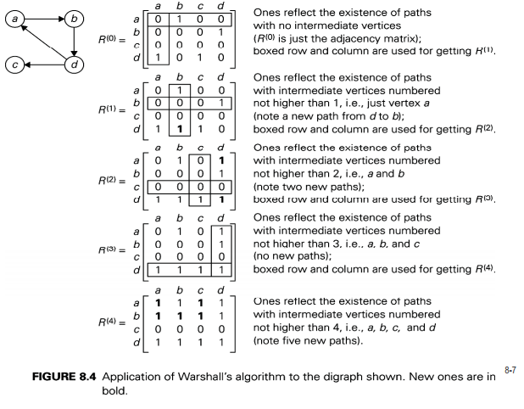
Example:

Slide 6
Floyd Warshall Algorithm
Repeat for I, J = 1, 2,…, M: [Initializes P.]
  If A[I, J] = 0, then: Set P[I, J] := ∞;
  Else Set P[I, J] := W(I, J).
  [End of loop.]
Repeat Steps 3 and 4 for K = 1, 2,…, M: [Updates P.]
Repeat Step 4 for I = 1, 2,…, M:
Repeat J= 1, 2,…, M:
Set P[I, J] := MIN(P[I, J], (P[I, K]+P[K, J])).
  [End of loop.]
  [End of Step 3 loop.]
  [End of step 2 loop.]
Exit

Slide 7
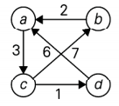
Example:

Slide 8
Thank You

